Slide 1

Board Meeting
January 7th, 2014

Slide 2
Agenda
Achievements - last 3 months
Focus & business model
Financials, HR & Ops
Next 3 months plan
daPulse – Round B

Slide 3
ACHIEVEMENTS - LAST 3 MONTHS

Slide 4
Position & Strategy
Found common,
dominant pain
Found a way to visualize
solution
Zeroing on a distinctive
positioning
Found early adapting
customers
Improving the pitch and
find relevant champions
Lack of operational transparency
Execution boards
Culture of transparency
Companies experiencing rapid growth
Management of growing companies (CEO/COO/CMO/VPs)
Notes:
We’ve done a lot of work in the past 4 months
Focused made hundreds of pitched and fined tunes our product & pitch.
We also got paying customers to work with us.

Slide 5

We fill the missing square
A must have tool for operational transparency
Notes:
Salesforce for xsales, jira for r&d, notihng for cross company projects.
This changes us from a nice to have to must have
ho

Slide 6
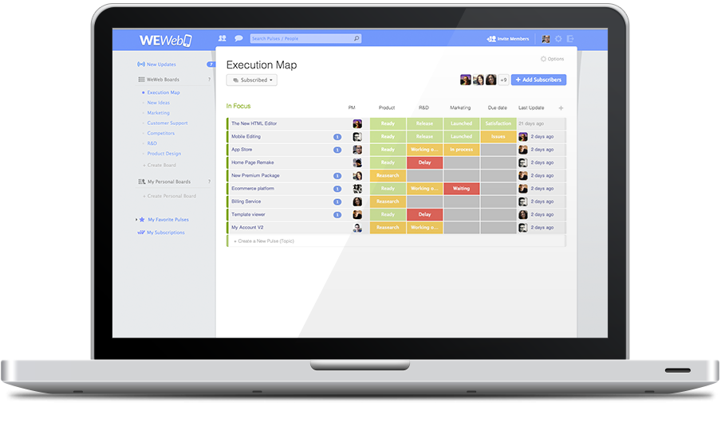
The solution to the product face

Slide 7

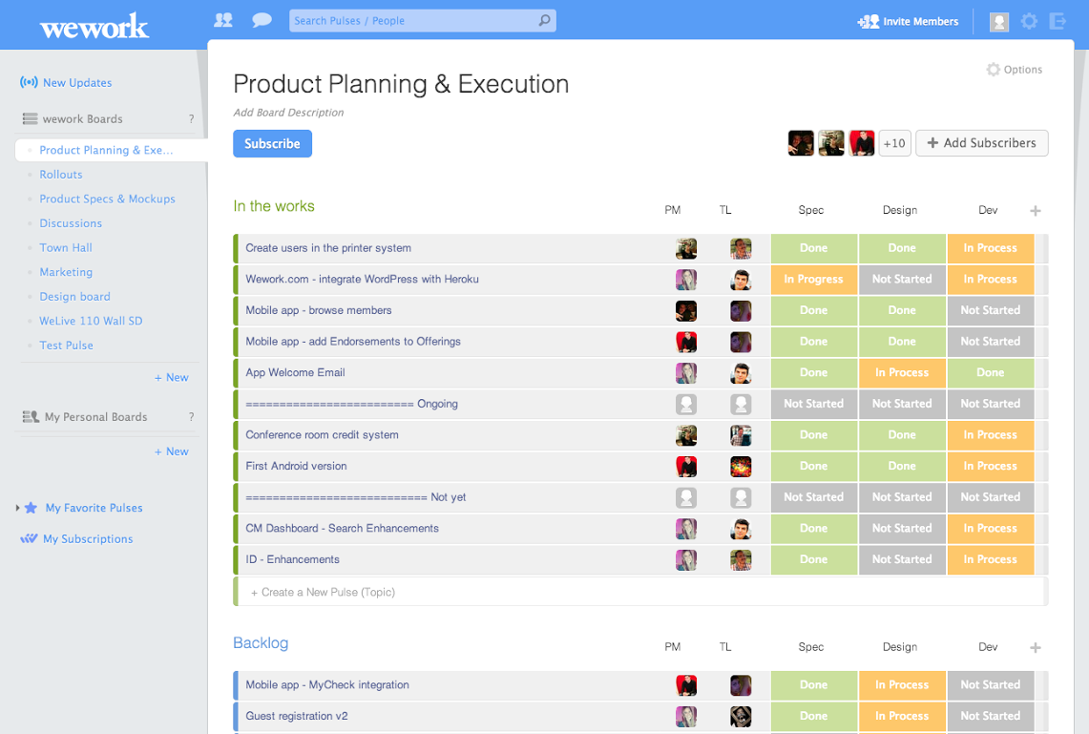
Boards - WeWork

Slide 8
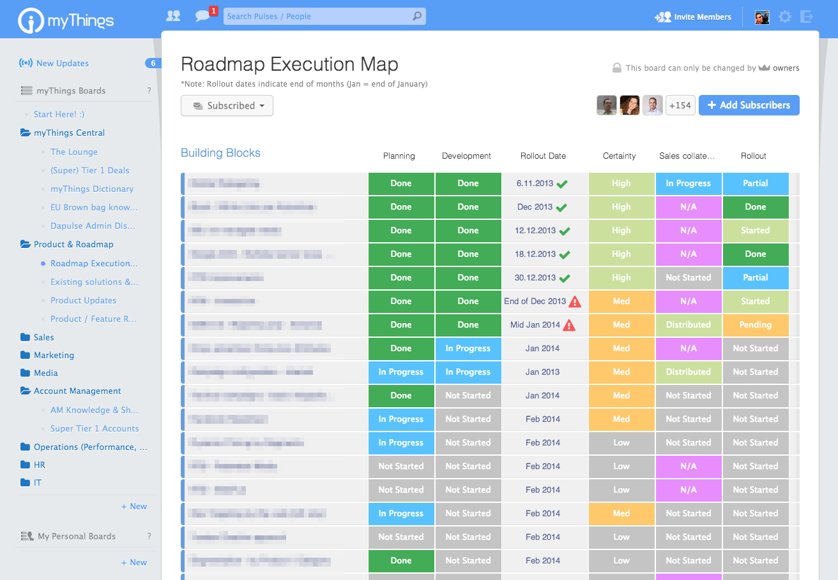
Boards – myThings

Slide 9
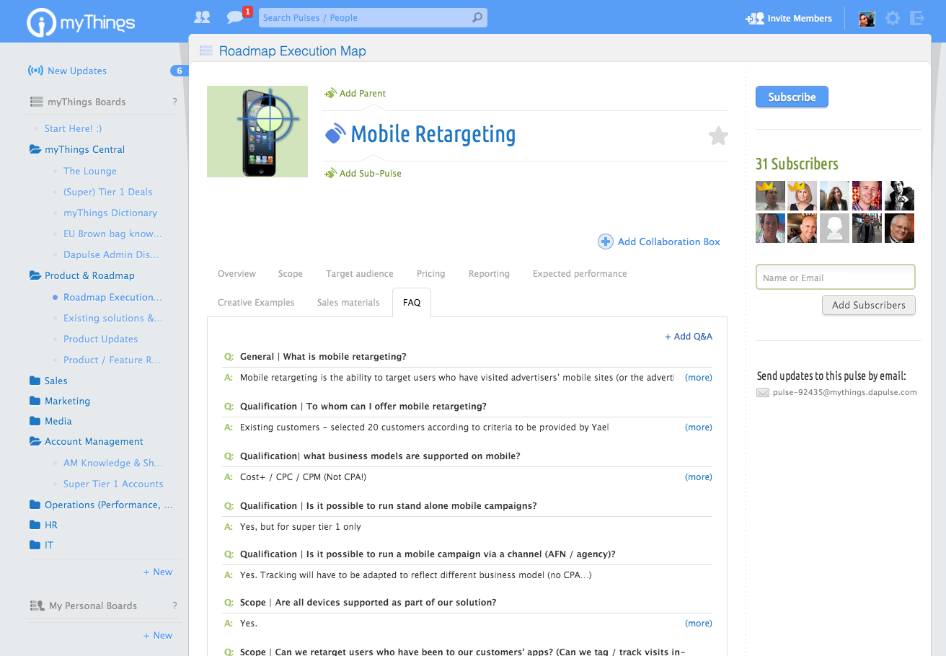
Boards – Pulse page

Slide 10
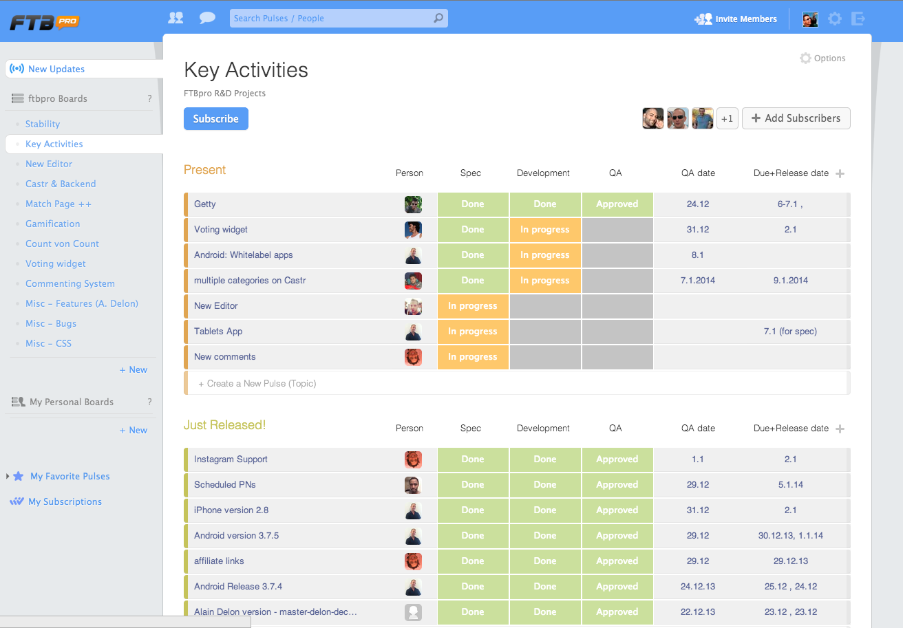
Boards – Pulse page

Slide 11
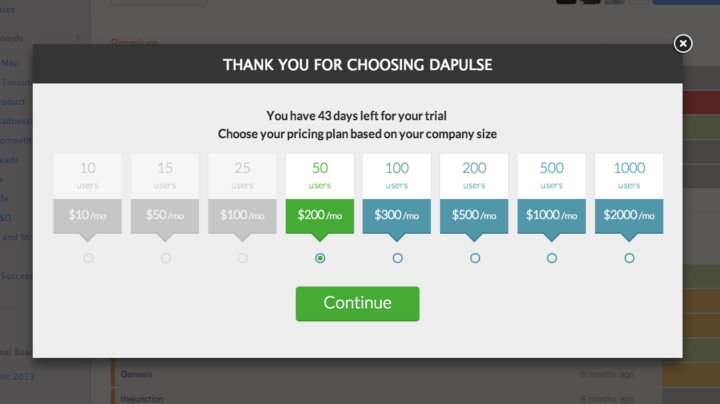
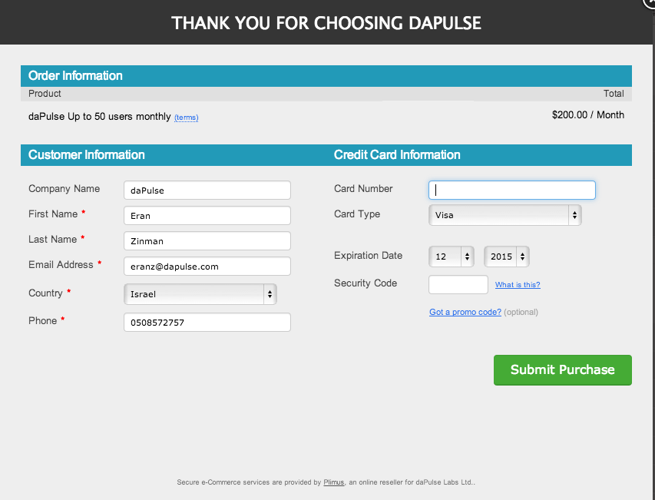
Launched Payments

Slide 12
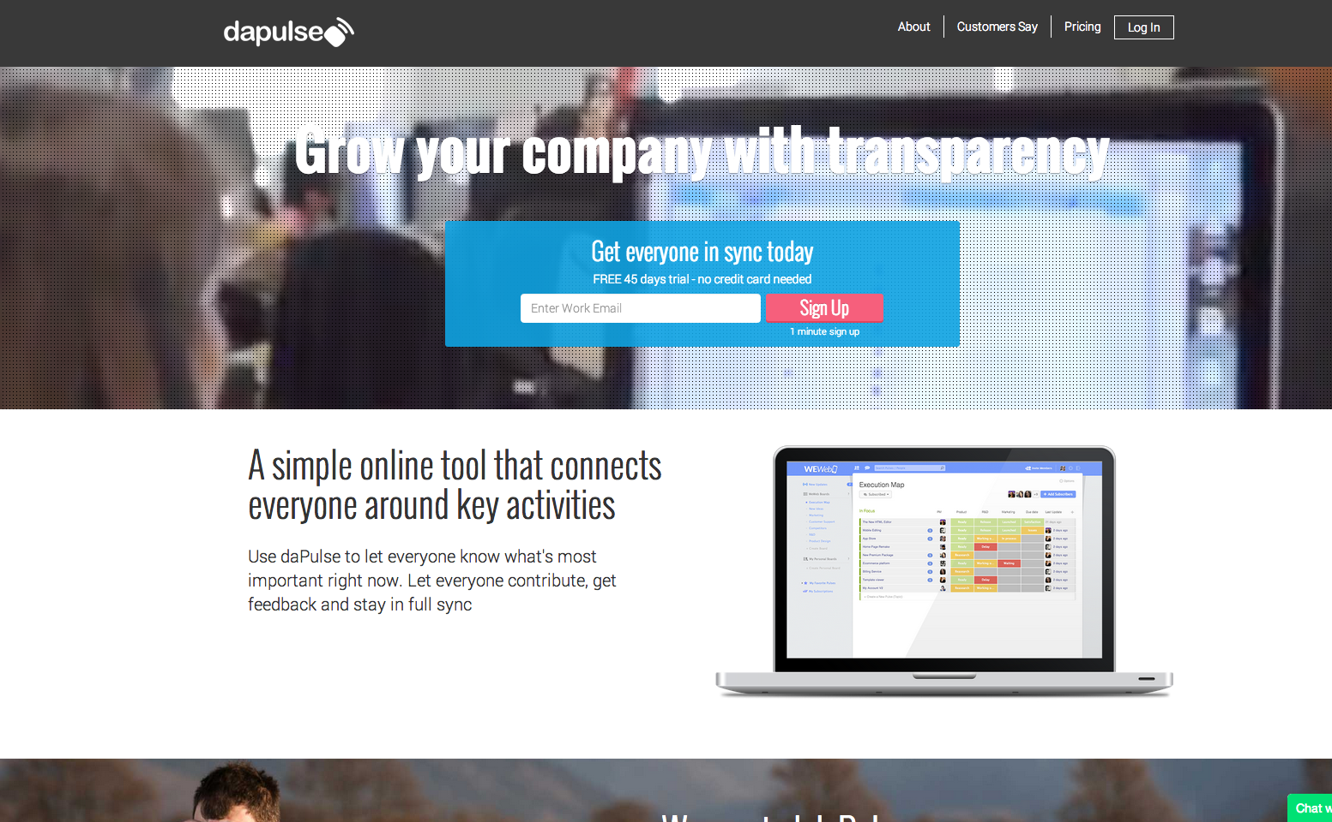
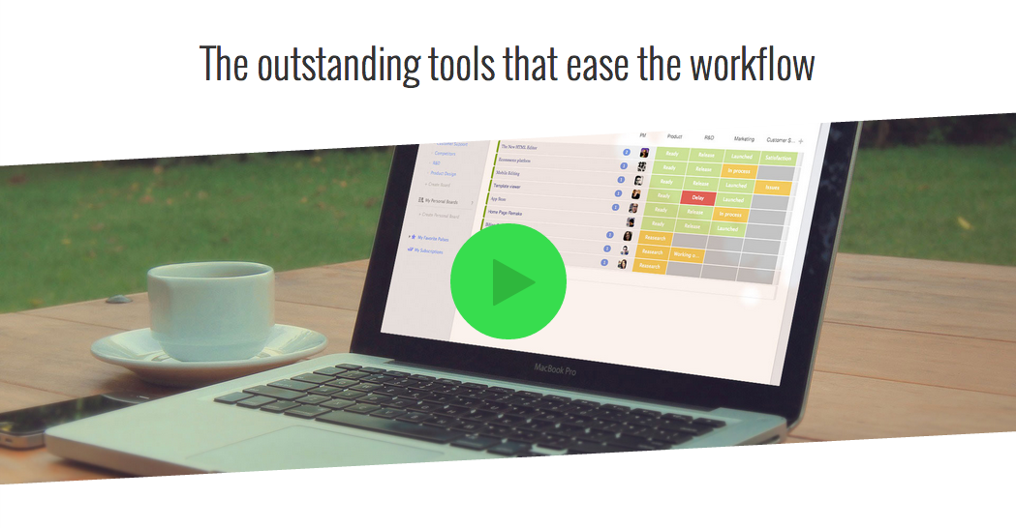
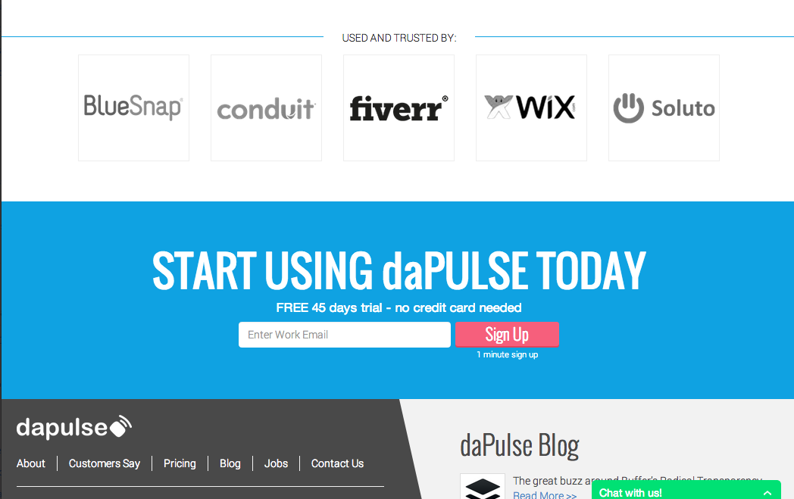
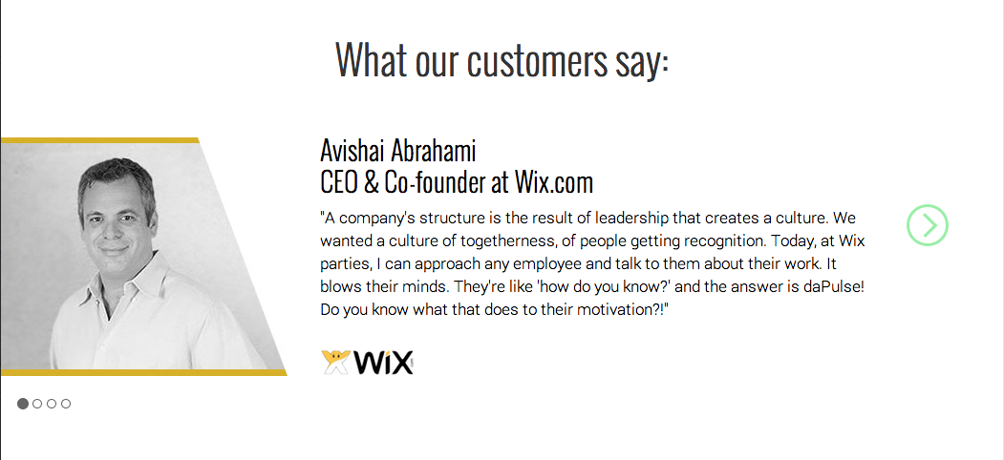
New Homepage

Slide 13

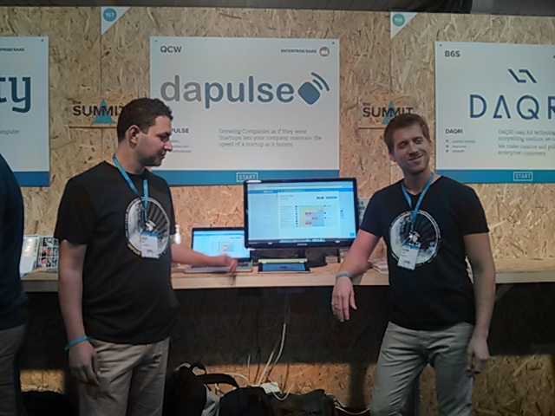
Web Summit
Hundreds of random pitches during 3 condensed days.
Helped a lot in improving and sharpening our pitch.
A lot of great feedback.
Some interesting leads (customers / investors).
Notes:
Prioritized out
- Mobile
- Increased Marketing – not R&D

Slide 14
Sales Focus & business model

Slide 15














Paying companies
Currently 6 paying companies
Convert remaining committed companies
Our goal in the next 3 months:
25 paying companies, monthly income > $10K

Slide 16
Sales Model
Low touch inbound sales model
$50 - $200 MRR / Customer
Low friction, one touch sale
Single decision point
Inbound sales, as we are at the $2 - $6 per user
price point
Start at 40-100 employees, then go enterprise

Slide 17
Operational Focus
Build sales operation
  Inbound leads > Signup > Adoption > Pay > Recur
  Outbound Leads > Demo > Pay > Adoption > Recur
Main 3 objections we want to kill
  Friction of “adding another tool”
  Getting the whole company to use – seems daunting
  Managers feel they need effort to make employees use.
Increase inbound traffic
  Content marketing
  Increase viral spread
  Email campaigns
  Blog posts
  Meetups / Thought Leadership

Slide 18
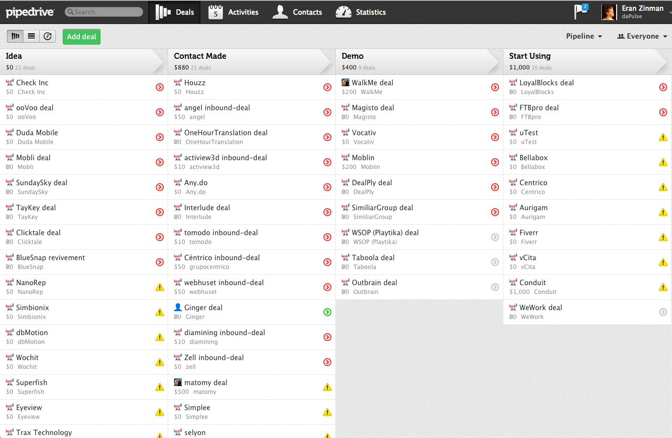
Sales CRM

Slide 19
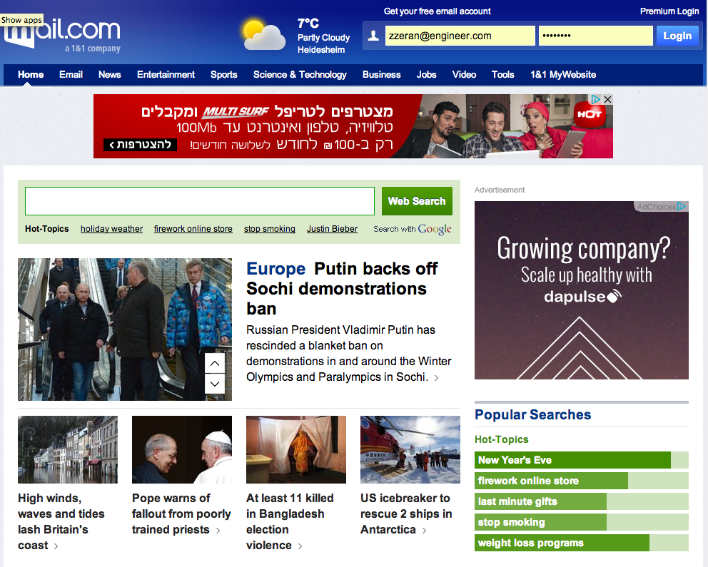

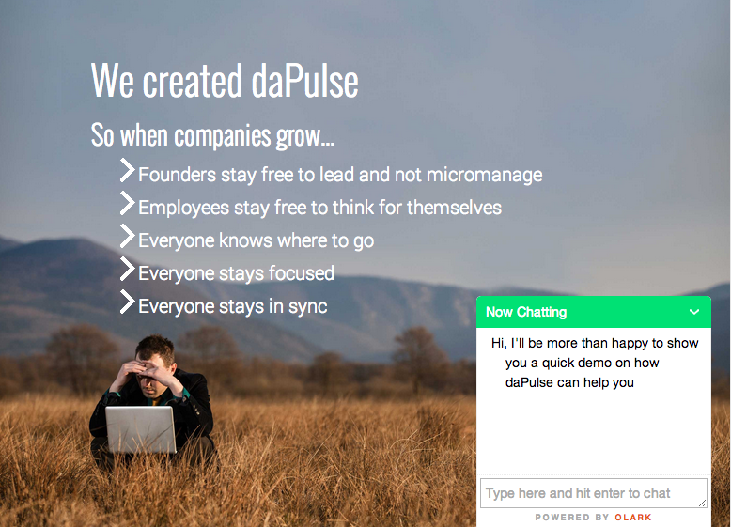
Live demo & retargeting
Proactive Chat
Retargeting Banners

Slide 20
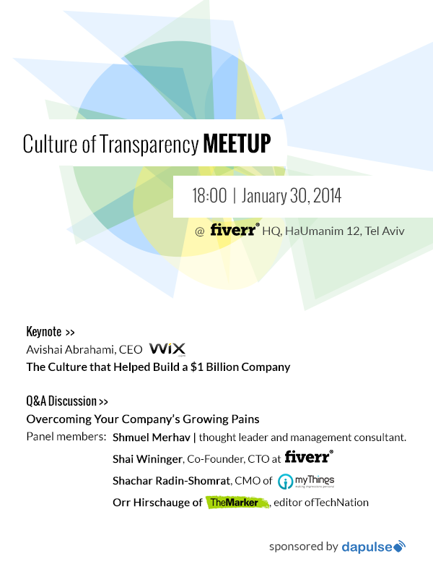
Culture of Transparency Meetup

Slide 21
Financials & HR

Slide 22
Financials
  Summary
  Expenses Breakdown
In Bank | $670K
Burn Rate | - $65K / Month
Revenue | + $6K / Month
Runway | ~ 11 Months

Slide 23
HR & Freelancers
Roy Man
CEO
Eran Zinman
Nevo Peretz
Daria Shualy
Tzafrir Rehan
Lior Brauer
Mickey Shulman
Rotem Waissman
Ayelet Yagil
R&D
Customer Success + Sales
Designer
Marketing
New
Freelancer
Maternity Leave

Slide 24
Next 3 months plan

Slide 25
High Level Plan
Sales, Sales, Sales
Get to 25 paying companies
Onboarding
Reduce adoption friction. One touch sale, convert using to recurring paying customers
External Integrations
Trello / Jira / Salesforce (will also reduce friction)
Mobile
beta iPhone version
daPulse Round B

Slide 26
Timeline
Onboarding + External Integrations
Beta iPhone Version
Round B ?
Sales Focus
Jan.
Feb.
Mar.
Apr.

Slide 27
Dapulse – round b

Slide 28
Next Round
Open Discussion
Timing – Start in March 2014?
Volume – 5M?
Who – Israel / US?
Team – what kind of help can I get from you?

Slide 29
Thank you

Slide 30
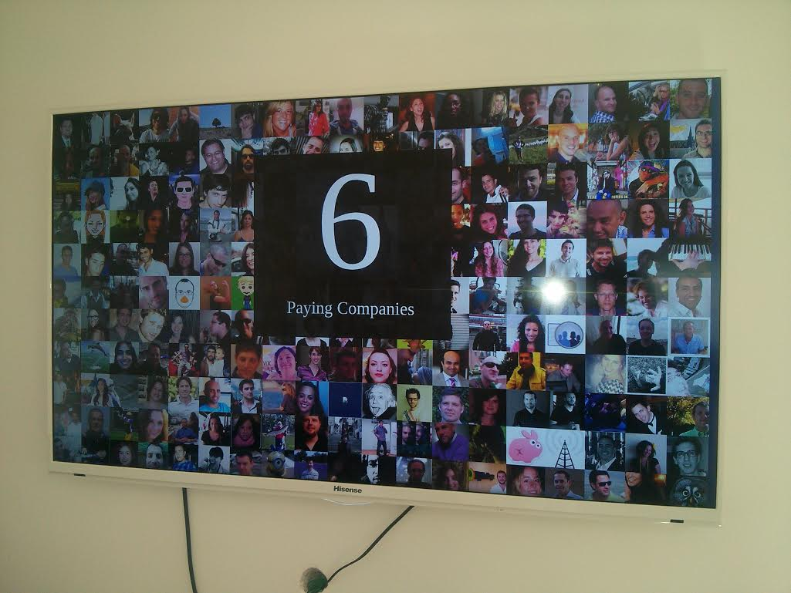
Sales Madness !

Slide 31
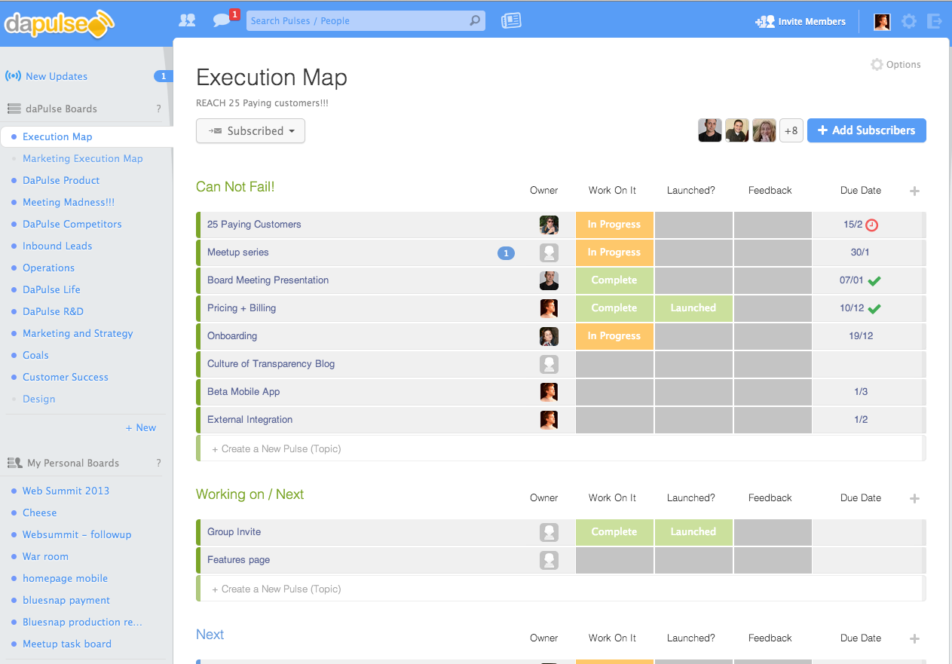
Transparency - our execution map

Slide 32
Funnel last 3 months
109 Approached
31 Pitched to
11 Trial
21 In process
2 Paying

